Slide 1
The structure of a C++ program
FRC team # 4941 Programming team
2018 DV Tate Testa

Slide 2
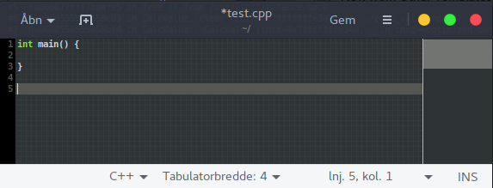
The simplest C++ program
This program is the simplest C++ program you can have. It does absolutely nothing.
The important thing to note here is that there has to be an int main() { } function in every C++ program.
Note: we are talking about glibc

Slide 3
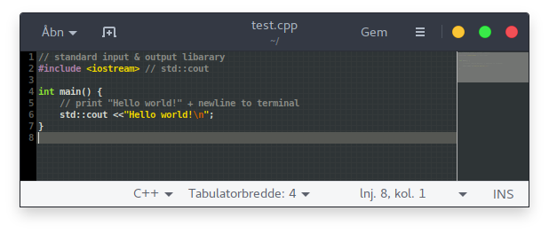
A more advanced example - Hello World!
Because C isn't built for any one particular purpose, the language itself doesn't include too much functionality out of the box. To account for this we need to use libraries.
In this example we used the library called iostream
iostream provided us with std::cout
if you didn't already guess, anything that starts with a // is a comment and gets ignored by the compiler
Next we will run our program

Slide 4
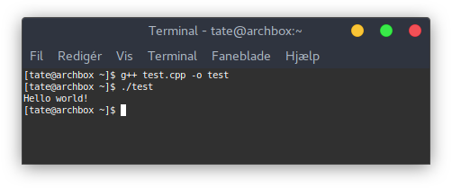
Running a program (Unix, Linux, OSX, etc.)
C++ is a compiled language, so before you can run it you first have to compile it.
g++ is the C++ compiler
compile file "test.cpp" into program "test"
run program "test"

